Slide 1

OLIST STORE ANALYSIS
PRESENTED BY
SHREYA C K
BHAGYASHREE ABHIJEET SANT SNIMY STEPHEN
SUBHASH CHANDRA THORVI

Slide 2



OBJECTIVE
The olist store analysis project aims to analyze customer purchasing patterns and payment statistics on an e- commerce platform, olist. This project covers several key performance indicators (kpis) such as weekday vs weekend sales, payment statistics, delivery time ,and customer behavior. The analysis is based on nine csv files, which are cleaned and manipulated to extract valuable insights including sales trends ,customer behavior
OLISTS STORE ANALYSIS
,product performance and segmentation. By examining
marketing historical
transactional data , demographic information , and customer feedback

Slide 3

Data Schema: The Olist Store dataset is structured as a relational database, with multiple tables that are interconnected to provide a comprehensive view of the e-commerce operations. The relationships between the tables can be visualized using an Entity-Relationship (ER) diagram. Here is an overview of the tables and their relationships:
OLISTS STORE ANALYSIS

Slide 4

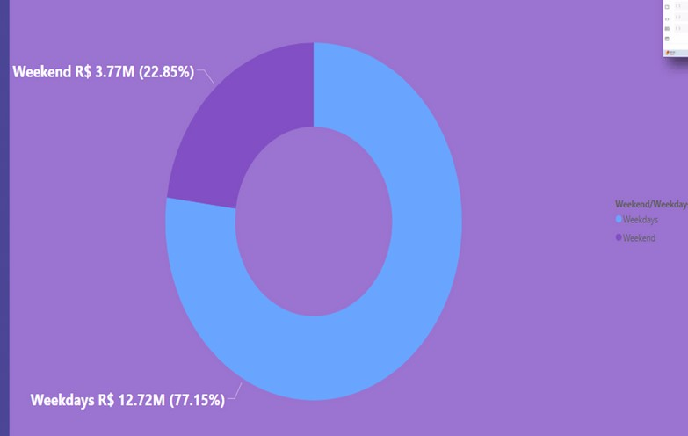
Weekday Vs Weekend Payment Statistics
Observations:
weekend contributes to 22.85% of the payment while weekdays day contributes to 77.15% of payment.
Conclusion:
payment contribution of weekend is less when compared to weekdays.
Suggestions:
--Weekend-Specific Promotions: Offer exclusive deals, discounts, or promotions during weekends to incentivize spending and attract more customers. Highlighting limited-time offers or special weekend events can create a sense of urgency and drive sales.
--Enhanced Customer Experience: Evaluate the shopping experience during weekends and identify any pain points or barriers that may discourage customers from making payments. Streamlining checkout processes, improving website performance, and providing responsive customer support can enhance satisfaction and increase conversion rates.
--Product Mix Optimization: Analyze which products or services perform well during weekdays versus weekends. Adjust your product mix or inventory levels to better align with weekend consumer preferences and cater to their needs effectively.
OLISTS STORE ANALYSIS
KPI-1

Slide 5
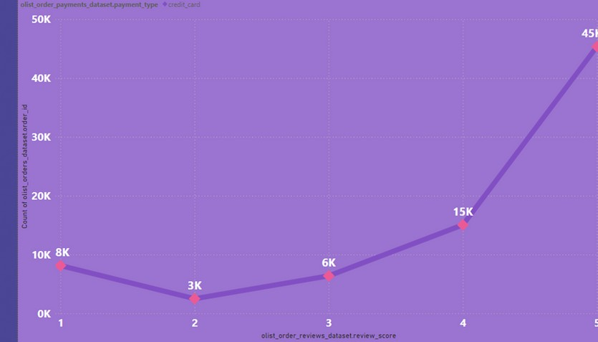
Number of Orders with review score 5 and payment type as credit card.
Observations:
number of orders for reviews score five are 45K with the payment type as credit card.
Conclusion:
The high number of orders with a review score of 5 and payment type as credit card suggests a strong correlation between customer satisfaction and payment convenience, potentially indicating a positive customer experience and trust in the credit card payment method.
Suggestions:
--Incentivize Credit Card Usage: Implement incentives or rewards programs specifically targeted at customers who choose to pay with credit cards. Offer cashback rewards, loyalty points, or exclusive discounts for credit card transactions to incentivize their usage and encourage repeat business.
--Educational Resources: Provide educational resources or guides to help customers understand the benefits and security features of credit card payments. Offer tips for safe online shopping practices and information about fraud prevention measures to build trust and confidence in credit card transactions.
OLISTS STORE ANALYSIS
KPI-2

Slide 6
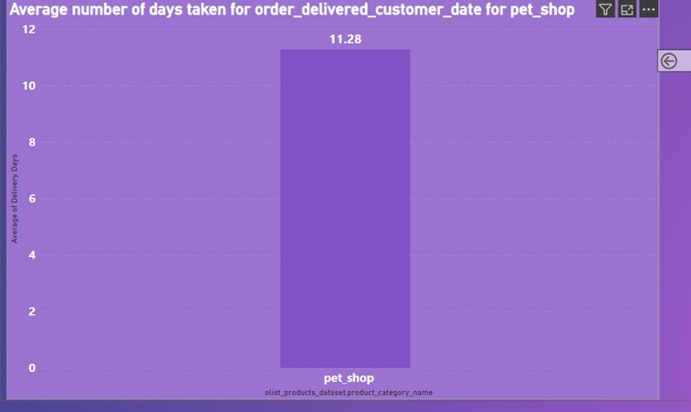
Observations: average number of days taken for order to be delivered for pet shop are 11.28 Conclusion: The shorter average delivery time for "pet_shop" orders indicates efficient and timely delivery processes, enhancing customer satisfaction and competitive advantage. Suggestion: --Invest in Technology: Leverage technology solutions such as route optimization software, predictive analytics, and automated order processing systems to streamline delivery operations and improve efficiency --Focus on Packaging Efficiency: Optimize packaging materials and processes to reduce packaging waste and minimize packaging dimensions.
Average number of days taken for delivery for product pet shop
KPI-3
OLISTS STORE ANALYSIS

Slide 7
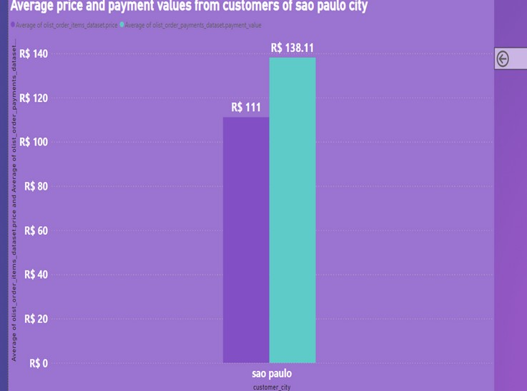
Observations: The Average price is R$111 and Average Payment Value is R$138.11 for Sao Palo city. Conclusion: The average price and payment values from customers of São Paulo city provide insights into the spending behavior and purchasing power of this demographic segment, aiding in market analysis and business strategy formulation. Suggestion: --Partnerships with Local Businesses: Collaborate with local businesses or influencers within São Paulo city to gain a better understanding of the local market dynamics and consumer preferences. Partnering with local brands or organizations can help tailor products and services to better meet the needs of São Paulo customers. --Localization of Marketing Campaigns: Develop localized marketing campaigns and promotions specifically targeted at customers in São Paulo city. Highlight products or services that resonate with the local culture, preferences, and lifestyle trends to attract and engage this demographic segment effectively.
Average price and payment values from customers of sao paulo city
KPI-4
OLISTS STORE ANALYSIS

Slide 8
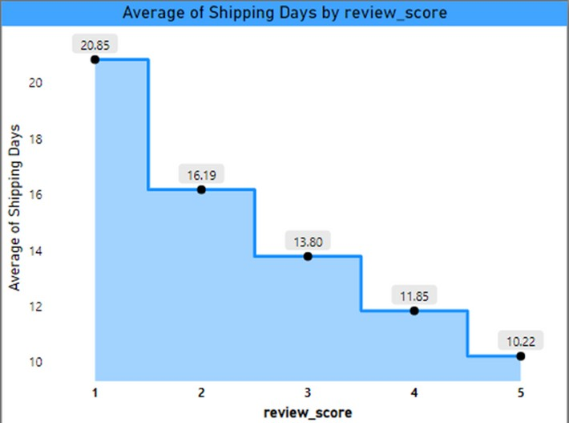
Observation: Review scores of 4 and 5 have notably lower average delivery days compared to scores of 1, 2, and 3. This indicates that customers who give higher review scores tend to experience faster delivery times, contributing to their overall satisfaction. Conclusion: Higher review scores correlate with shorter delivery times(indicates negative correlation), with the most significant impact on satisfaction seen at lower review scores. Suggestion: --Invest in Logistics Infrastructure: Upgrade logistics infrastructure and distribution networks to improve delivery speed and reliability. Expand warehousing facilities, optimize inventory management, and establish strategic partnerships with reliable shipping carriers to minimize transit times. --Utilize Express Shipping Options: Offer express shipping options for customers who prioritize faster delivery. Provide expedited shipping services with guaranteed delivery times for an additional fee to cater to time-sensitive orders and enhance customer satisfaction.
Relationship between shipping days Vs review scores.
KPI-5
OLISTS STORE ANALYSIS

Slide 9







KEY INSIGHTS
--According to the data, Olist E-commerce has about 99,440 orders. With about 89,940 orders being delivered, the company has a 90% delivery success rate.
--Their average product rating is 4.09 stars, with product categories going as high as 4.67 stars and as low as 2.5 stars. 1 Star reviews are on third place in the review score distribution ranking which likely indicates that there could be problems with product quality in some product categories.
--It helps in understanding the spending patterns of customers in sao paulo city .it also helps Olist in identifying high value customers and creating targeted marketing campaigns.
--The analysis of payment statistics based on weekday vs. weekend provides an understanding of the buying behavior of customers and can also help Olist to improve their weekend sales and plan promotions accordingly.
OLISTS STORE ANALYSIS

Slide 10
ADDITIONAL INSIGHTS
--Geographical Analysis:
Understand customer distribution, Identify new market opportunities , Highlight high-demand areas with longer delivery times or higher shipping costs, Optimize delivery routes and logistics for efficiency and cost reduction
--Frequent Purchase Analysis:
Identify top 10 product categories by order frequency, Bed bath table (Cama_mesa_banho) most frequently purchased with 10K orders
--Profit Margin Analysis:
Evaluate each product's profit contribution , Signaling and security (Sinalizacao_e_seguranca) has highest profit margin of R$38, Home appliances 2 (eletrodomesticos_2) has least profit margin (-R$10).
--Customer Acquisition Analysis: Analyze first-time product purchases
OLISTS STORE ANALYSIS

Slide 11






Thank you

